Slide 1
Alzheimer’s Disease Prediction
Subject : Data Structures and Algorithm in Python
Prof. Sanja Damjanovic
Sahana Srinivasa Babu
Meenakshi Rajpurohit
Bishakha

Slide 2
Objective
To build a machine learning model that can accurately predict the presence of Alzheimer’s disease in patients based on clinical data, in order to support early diagnosis and improve treatment planning.
Project Flow:
Load and Inspect Data: Check for missing values, duplicates, and incorrect data types.
Exploratory Data Analysis (EDA): Visualize the data to find patterns and insights.
Data Preprocessing: Clean the data and scale the features for modeling.
Model Training: Train four different classification models.
Model Evaluation: Compare the models using accuracy and confusion matrices.
Feature Importance: Identify the most influential factors for prediction.

Slide 3
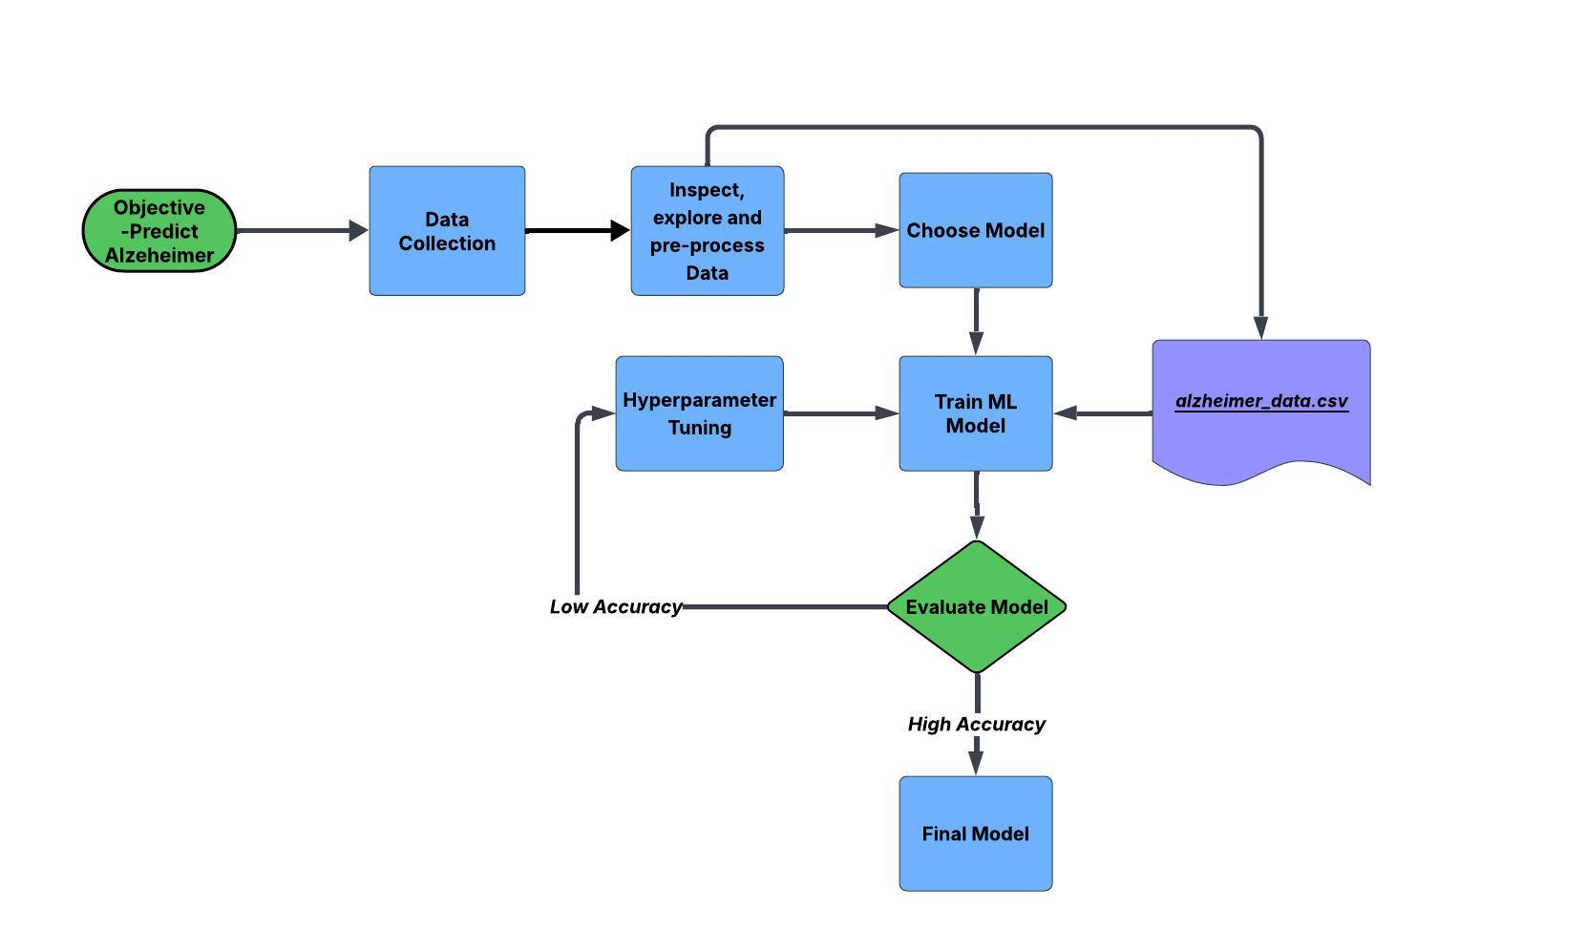
Flowchart

Slide 4
Exploratory Data Analysis
Dataset : https://www.kaggle.com/datasets/rabieelkharoua/alzheimers-disease-dataset/data
Columns: PatientID, Age, Gender, Ethnicity, EducationLevel, BMI, Smoking, AlcoholConsumption, PhysicalActivity, DietQuality, SleepQuality, FamilyHistoryAlzheimers, CardiovascularDisease, Diabetes, Depression, HeadInjury, Hypertension, SystolicBP, DiastolicBP, CholesterolTotal ,CholesterolLDL, CholesterolHDL, CholesterolTriglycerides, MMSE, FunctionalAssessment, MemoryComplaints, BehavioralProblems, ADL, Confusion, Disorientation, PersonalityChanges, DifficultyCompletingTasks, Forgetfulness, Diagnosis, DoctorInCharge. (Total 35 columns)
Rows : 2149 Patient Dataset

Slide 5
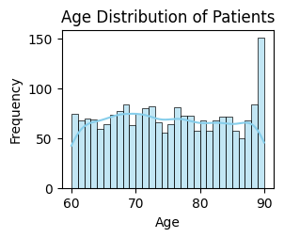
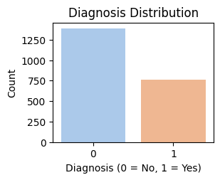
Diagrams : Age And Diagnosis Distribution

Slide 6
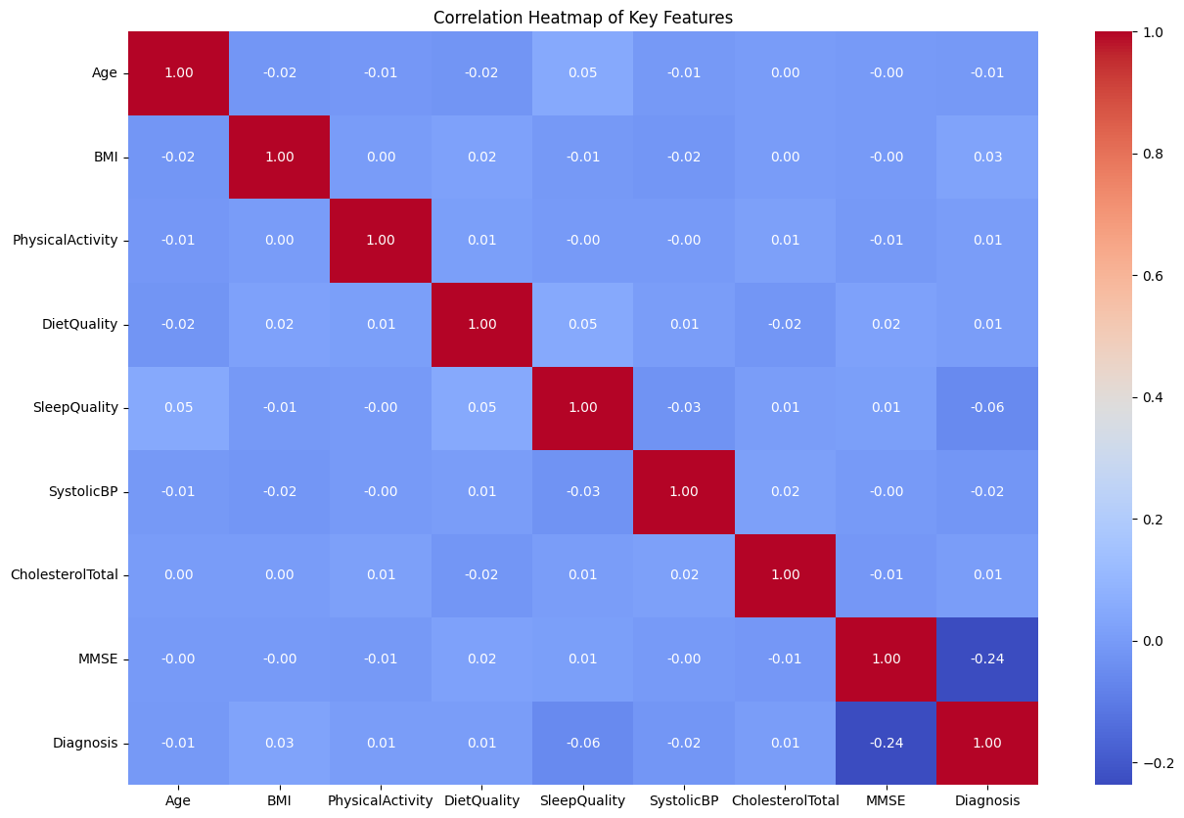
Correlation Heatmap

Slide 7
Unique , Null And Duplicate Records
After the initial Data Exploration following can be summarized about dataset:
The dataset contains a total of 2,149 observations.
All values in the dataset are non-null and numerical.
There are no duplicate records.
Unique values for a column can be found using unique() function.

Slide 8
Data Preprocessing
Drop `DoctorInCharge` and `PatientID` columns using drop() function.
Separate Features(X), also called independent variables and Target(y), also called dependent variable.
Split the data using train_test_split() function.
Scale the data using StandardScaler() function.

Slide 9
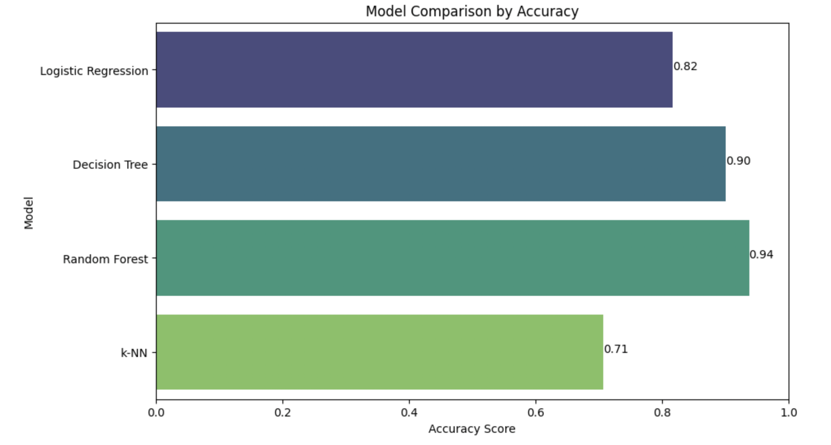
Model Performance (Comparison)
RESULT
Model | Accuracy
Logistic Regression | 82%
Decision Tree | 90%
Random Forest | 94% (Best)
K-NN | 71%
Logistic Regression

Slide 10
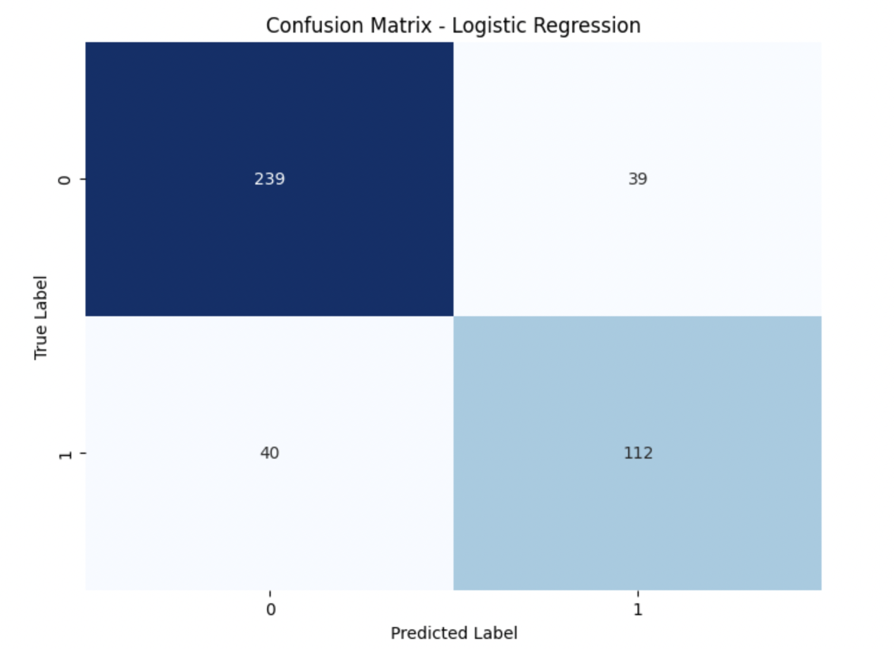
Logistic Regression
Linear model, interpretable and fast.
Works well with linearly separable data.
Classification Report
 | precision | recall | f1-score
0 | 0.86 | 0.86 | 0.86
1 | 0.74 | 0.74 | 0.74
Accuracy - 0.82

Slide 11
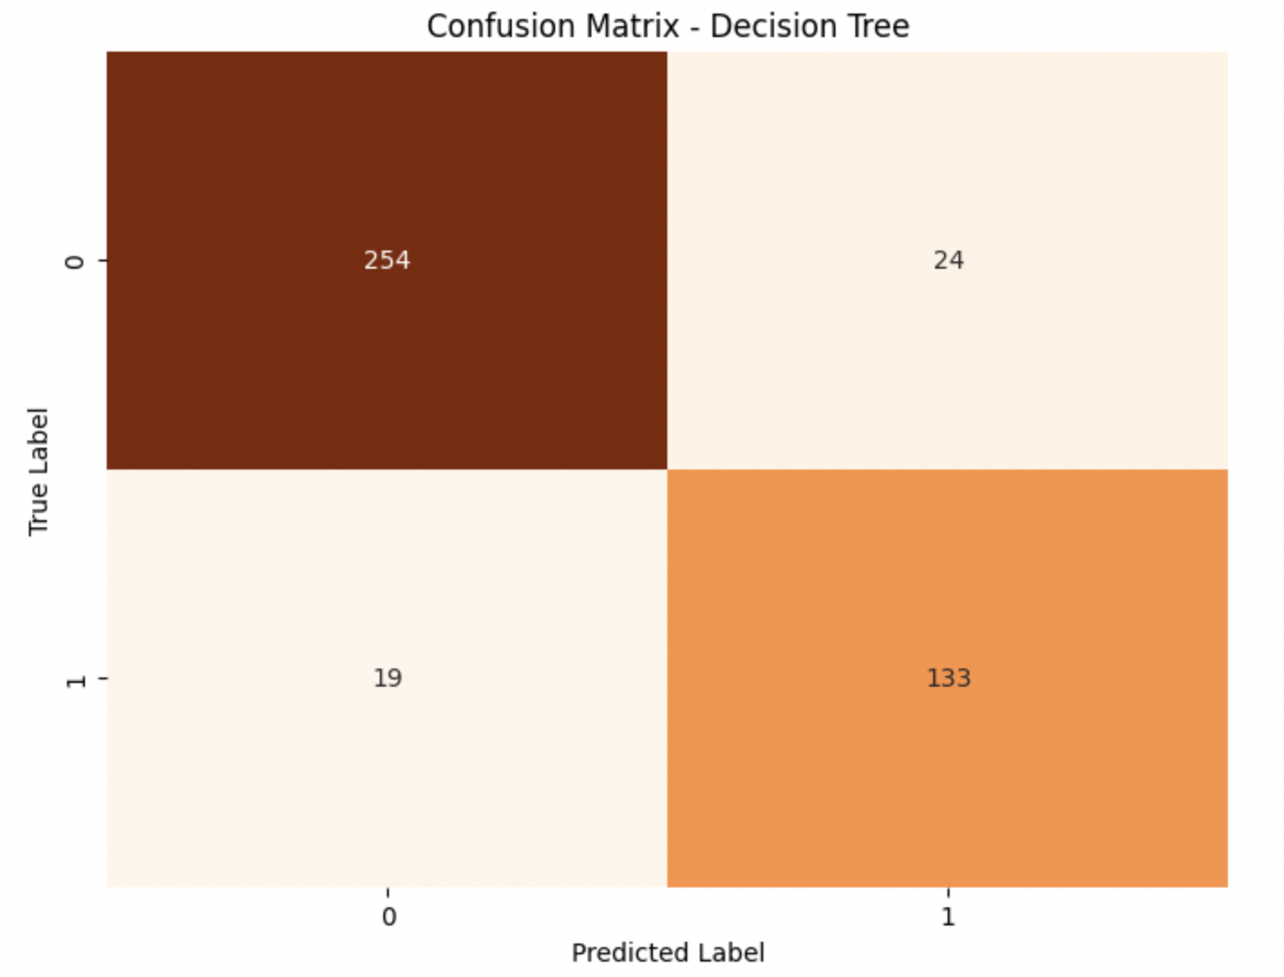
Decision Tree
Tree-based model that splits data.
Handles both numerical and categorical data.
Classification Report
 | precision | recall | f1-score
0 | 0.93 | 0.91 | 0.92
1 | 0.85 | 0.88 | 0.86
Accuracy - 0.90

Slide 12
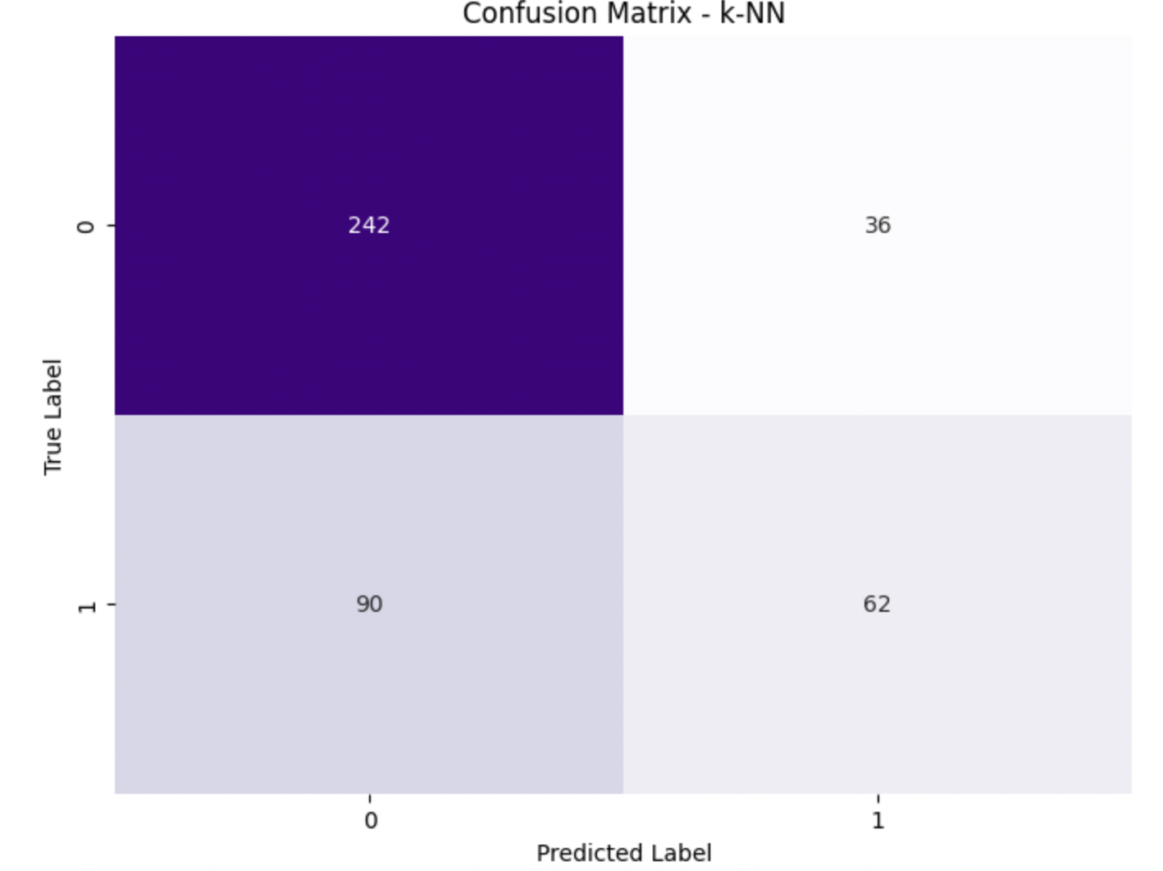
K-Nearest Neighbors (k-NN)
Instance-based algorithm that classifies based on majority vote of nearest neighbors.
Performance depends on the choice of k and can be slow on large dataset.
Classification Report
 | precision | recall | f1-score
0 | 0.73 | 0.87 | 0.79
1 | 0.63 | 0.41 | 0.50
Accuracy - 0.71

Slide 13
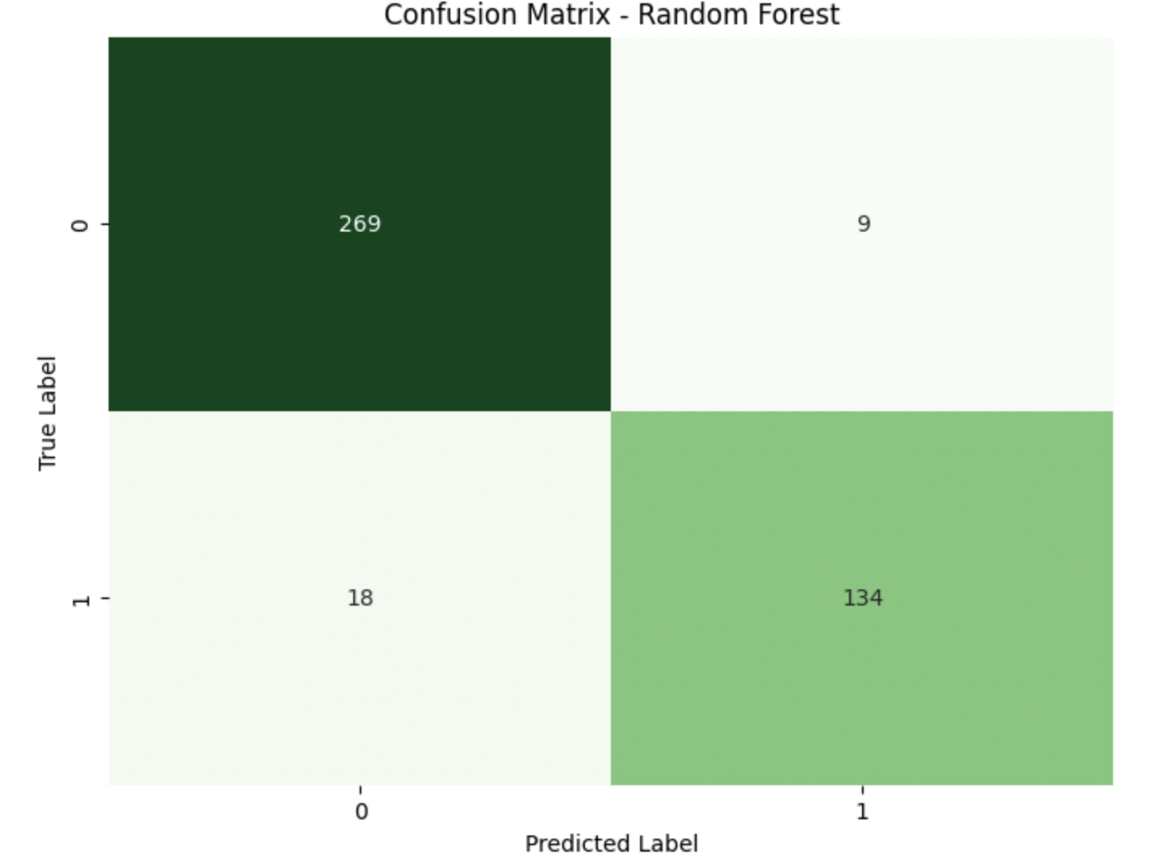
Random Forest
Ensemble of multiple decision trees.
Reduces overfitting compared to a single decision tree.
Provides feature importance scores to understand key predictors.
Classification Report
 | precision | recall | f1-score
0 | 0.94 | 0.97 | 0.95
1 | 0.94 | 0.88 | 0.91
Accuracy - 0.94

Slide 14
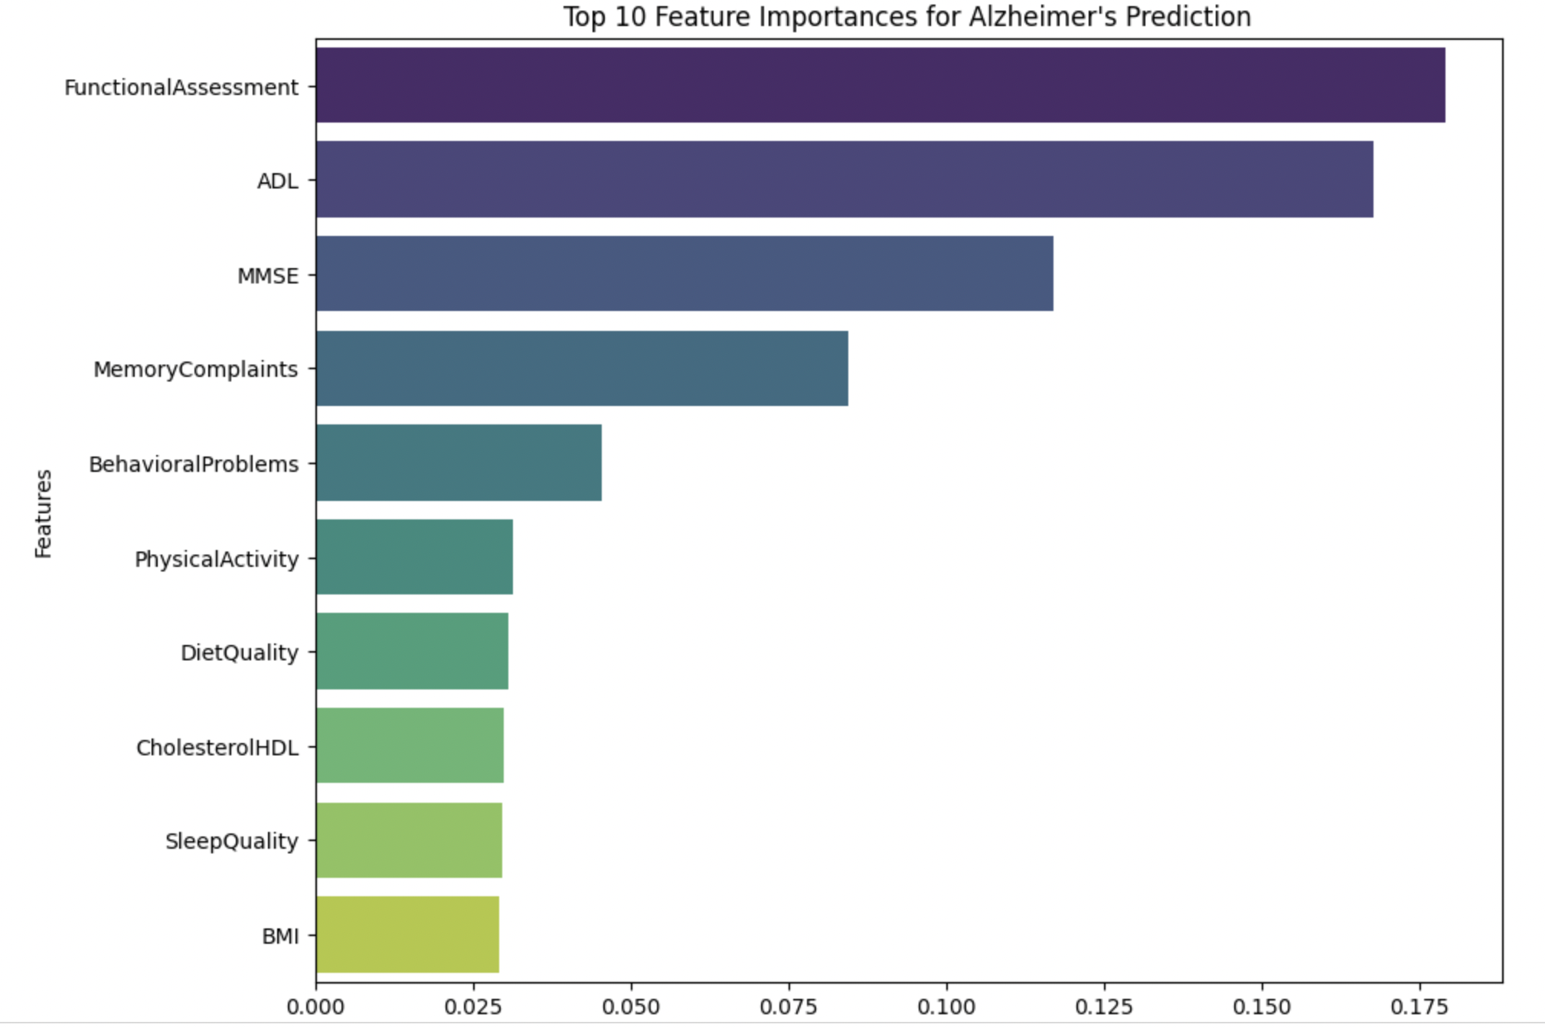
Important Features for Detection
Our trained Random Forest model has a property called 'feature_importances_'.
This gives us a score for how important each feature was in making predictions
These top 10 features are listed below.
Functional Assessment
ADL
MMSE
Memory Complaints
Behavioral Problems
Physical Activity
Diet Quality
Cholesterol HDL
Sleep Quality
BMI

Slide 15
Conclusion
Among all models tested, Random Forest achieved the highest accuracy (94%).
Important predictors include Functional Assessment, ADL, MMSE, Memory Complaints, Behavioral Problems.
Ensemble models (Random Forest) outperformed simpler models (Logistic Regression, KNN).
Proper preprocessing (scaling, handling null values, removing duplicates) improved overall model performance.
Early detection of Alzheimer’s through ML can support timely medical interventions.

Slide 16
Reference
[1] C. Jose, Preety, and Vidushi. Comparative Analysis of Machine Learning Algorithms for Predicting Alzheimer's Disease. - https://doi.org/10.1109/ICUIS64676.2024.10867186
[2] J. Neelaveni and M. S. G. Devasana. Alzheimer Disease Prediction using Machine Learning Algorithms. - https://doi.org/10.1109/ICACCS48705.2020.9074248
[3] A. D. Arya, S. Singh Verma, P. Chakarabarti, and R. Bishnoi. Prediction of Alzheimer's Disease – A Machine Learning Perspective with Ensemble Learning. - https://doi.org/10.1109/IC3I59117.2023.10397683
[4] V. R, S. U, T. Shetty, and N. Guruprasad. Comprehensive Methodologies for Alzheimer’s Disease Prediction: A Machine Learning Approach. - https://doi.org/10.1109/ICICAT62666.2024.10923447

